Slide 1
Covariance Matrix
Robert Kissell
Fall 2017

Slide 2
Portfolio Risk Models

Slide 3
Start with Some Simple Math

Slide 4

Question #1
$$Solve the Following Equation:$$
$$2x+5y=19$$
$$8x−2y=10$$

Slide 5

Question #1
$$Solve the Following Equation:$$
$$2x+5y=19$$
$$8x−2y=10$$
$$x=2$$
$$y=3$$
Two (2) Equations & Two (2) Unknowns.
This system of equations has a unique solution!
The columns are linearly independent - ☺

Slide 6

Question #2
$$Solve the Following Equation:$$
$$x+y+3z=10$$
$$x−y+2z=45$$
Two (2) Equations & Three (3) Unknowns.
This system of equations has a multiple solutions ☹.
The columns are not linearly dependent.
The matrix does not have full rank.

Slide 7



Question #2
$$Solve the Following Equation:$$
$$x+y+3z=10$$
$$x−y+2z=45$$
$$x=5, y=2, z=1$$
$$x=2.5, y=1.5, z=2$$
$$x=0, y=1, z=3$$
Two (2) Equations & Three (3) Unknowns.
This system of equations has a multiple solutions ☹.
The columns are not linearly dependent.
The matrix does not have full rank.

Slide 8
Covariance Matrix

Slide 9
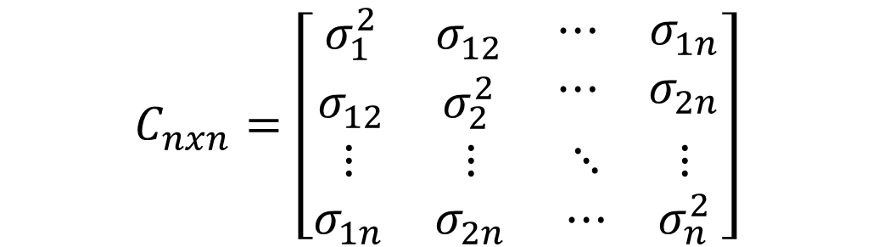
Covariance Matrix
$$C_{nxn}=\left[\begin{matrix}\begin{matrix}σ_{1}^{2} & σ_{12} \\ σ_{12} & σ_{2}^{2}\end{matrix} & \begin{matrix}⋯ & σ_{1n} \\ ⋯ & σ_{2n}\end{matrix} \\ \begin{matrix}⋮ & ⋮ \\ σ_{1n} & σ_{2n}\end{matrix} & \begin{matrix}⋱ & ⋮ \\ ⋯ & σ_{n}^{2}\end{matrix}\end{matrix}\right]$$
A Covariance Matrix is symmetric.
A Covariance Matrix for n-stocks has the following number of unique parameters:
$$\#unique parameters= \frac{\left(n^{2}−n\right)}{2}+n=\frac{n∙\left(n+1\right)}{2}$$

Slide 10
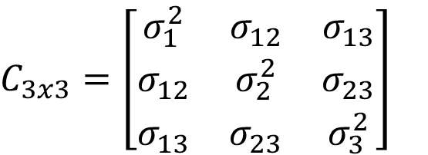


Covariance Matrix
$$C_{3x3}=\left[\begin{matrix}σ_{1}^{2} & σ_{12} & σ_{13} \\ σ_{12} & σ_{2}^{2} & σ_{23} \\ σ_{13} & σ_{23} & σ_{3}^{2}\end{matrix}\right]$$
$$\# unique=\frac{3\left(3+1\right)}{2}=6$$
$$parameters=σ_{1}^{2},σ_{2}^{2},σ_{3}^{2}, σ_{12},σ_{13},σ_{23}$$

Slide 11

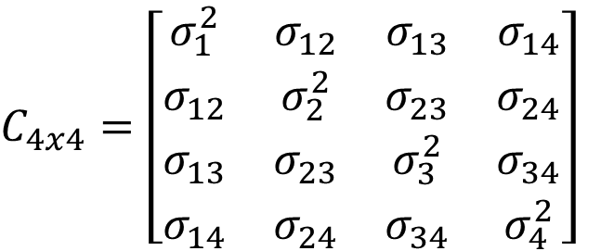
Covariance Matrix
$$C_{3x3}=\left[\begin{matrix}σ_{1}^{2} & σ_{12} & σ_{13} \\ σ_{12} & σ_{2}^{2} & σ_{23} \\ σ_{13} & σ_{23} & σ_{3}^{2}\end{matrix}\right]$$
$$\# unique=\frac{3\left(3+1\right)}{2}=6$$
$$parameters=σ_{1}^{2},σ_{2}^{2},σ_{3}^{2}, σ_{12},σ_{13},σ_{23}$$
$$C_{4x4}=\left[\begin{matrix}σ_{1}^{2} & σ_{12} & σ_{13} & σ_{14} \\ σ_{12} & σ_{2}^{2} & σ_{23} & σ_{24} \\ σ_{13} & σ_{23} & σ_{3}^{2} & σ_{34} \\ σ_{14} & σ_{24} & σ_{34} & σ_{4}^{2}\end{matrix}\right]$$
$$\# unique=\frac{4\left(4+1\right)}{2}=10$$
$$parameters=σ_{1}^{2},σ_{2}^{2},σ_{3}^{2},σ_{4}^{2},σ_{12},σ_{13},σ_{14}{,σ}_{23}{,σ}_{24}{,σ}_{34}$$

Slide 12
Covariance Matrix – Lets do the Math

Slide 13
Covariance Matrix – Lets do the Math

Slide 14
Covariance Matrix – Lets do the Math

Slide 15
Covariance Matrix – Lets do the Math

Slide 16
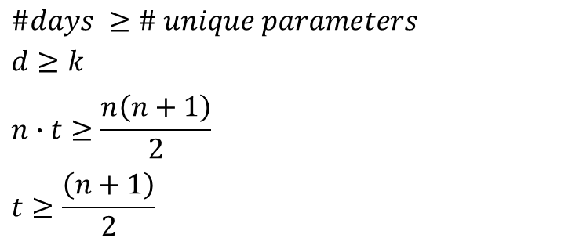
How many days of data do we need?
Number of data points “d” has to be greater than or equal to the number of parameters “k” (remember 8th grade algebra! – we need more equations than unknowns)
There are n-stocks, therefore, on t-days we will have n*t data points.
There are n*(n+1)/2 unique parameters.
Therefore, we need to have at least “ t* ” days to be able to estimate a “valid” covariance matrix.
But then we still have to worry about statistical accuracy (perhaps 10 or 20 data points for each parameter value.
$$\#days ≥\# unique parameters$$
$$d≥k$$
$$n∙t≥\frac{n\left(n+1\right)}{2}$$
$$t≥\frac{\left(n+1\right)}{2}$$

Slide 17
Covariance Matrix – Lets do the Math

Slide 18
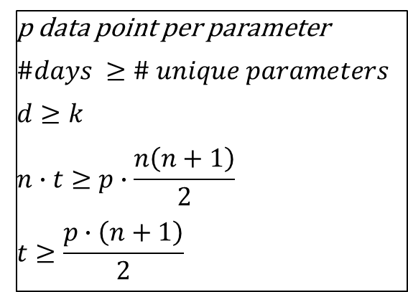
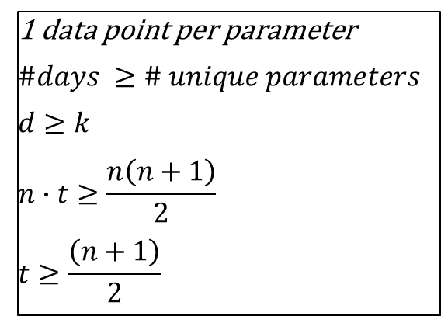
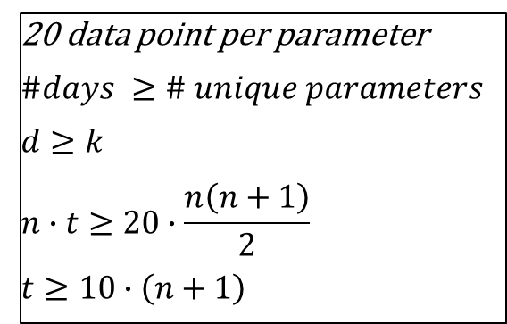
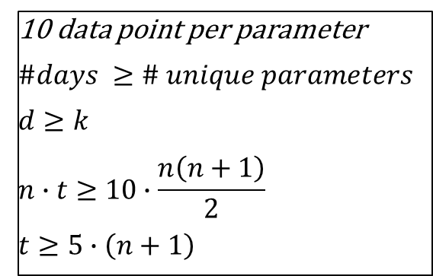
Covariance Matrix – Lets do the Math
1 data point per parameter
$$\#days ≥\# unique parameters$$
$$d≥k$$
$$n∙t≥\frac{n\left(n+1\right)}{2}$$
$$t≥\frac{\left(n+1\right)}{2}$$
p data point per parameter
$$\#days ≥\# unique parameters$$
$$d≥k$$
$$n∙t≥p∙\frac{n\left(n+1\right)}{2}$$
$$t≥\frac{p∙\left(n+1\right)}{2}$$
10 data point per parameter
$$\#days ≥\# unique parameters$$
$$d≥k$$
$$n∙t≥10∙\frac{n\left(n+1\right)}{2}$$
$$t≥5∙\left(n+1\right)$$
20 data point per parameter
$$\#days ≥\# unique parameters$$
$$d≥k$$
$$n∙t≥20∙\frac{n\left(n+1\right)}{2}$$
$$t≥10∙\left(n+1\right)$$

Slide 19
Covariance Matrix – Lets do the Math

Slide 20
Covariance Matrix – Lets do the Math

Slide 21
Covariance Matrix – Lets do the Math

Slide 22
Factor Models

Slide 23

Factor Model
$$r_{t}=a_{0}+b_{1}f_{1}+b_{2}f_{2}+ …+{b_{k}f}_{k}+e_{t}$$

Slide 24
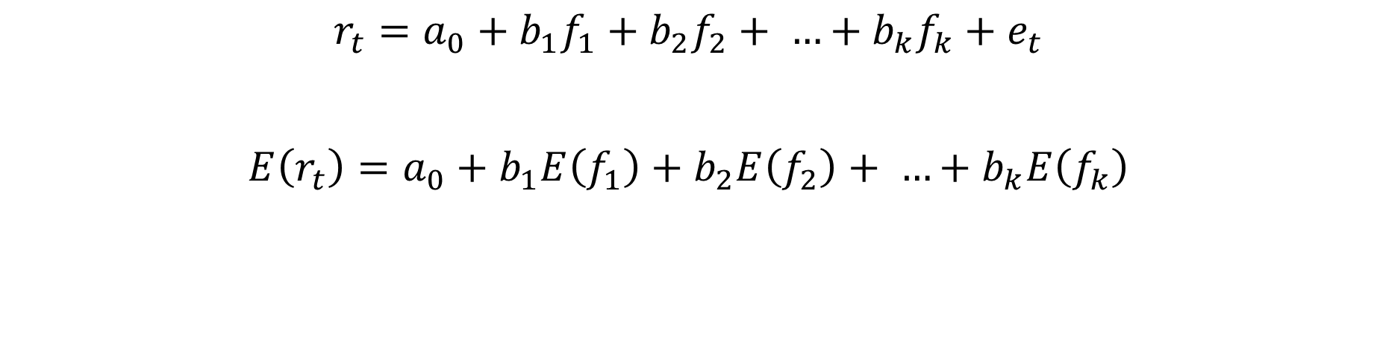
Factor Model
$$r_{t}=a_{0}+b_{1}f_{1}+b_{2}f_{2}+ …+{b_{k}f}_{k}+e_{t}$$
$$E\left(r_{t}\right)=a_{0}+b_{1}E\left(f_{1}\right)+b_{2}E\left(f_{2}\right)+ …+b_{k}E\left(f_{k}\right)$$

Slide 25
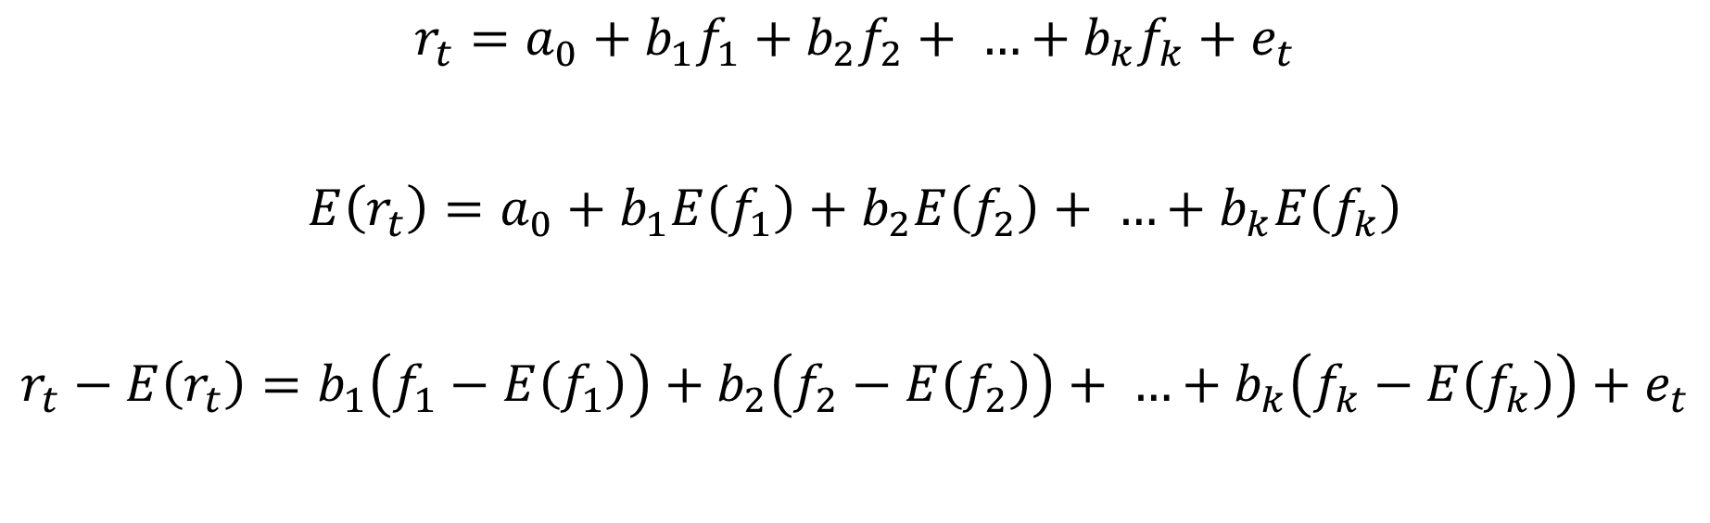
Factor Model
$$r_{t}=a_{0}+b_{1}f_{1}+b_{2}f_{2}+ …+{b_{k}f}_{k}+e_{t}$$
$$E\left(r_{t}\right)=a_{0}+b_{1}E\left(f_{1}\right)+b_{2}E\left(f_{2}\right)+ …+b_{k}E\left(f_{k}\right)$$
$$r_{t}−E\left(r_{t}\right)=b_{1}\left(f_{1}−E\left(f_{1}\right)\right)+b_{2}\left(f_{2}−E\left(f_{2}\right)\right)+ …+b_{k}\left(f_{k}−E\left(f_{k}\right)\right)+e_{t}$$

Slide 26

Factor Model
$$r_{t}^{∗}=b_{1}f_{1}^{∗}+b_{2}f_{2}^{∗}+ …+f_{k}^{∗}+e_{t}$$
$$E\left(r_{t}^{∗}\right)=0, E\left(f_{k}^{∗}\right)=0$$

Slide 27


Factor Models
$$r_{t}^{∗}=b_{1}f_{1t}^{∗}+b_{2}f_{2t}^{∗}+..+b_{k}f_{kt}^{∗}+ε$$
$$R=FB+e$$
$$\underset{txn}{R}=\underset{txk }{F}\underset{kxn}{B}+\underset{txn}{e}$$

Slide 28

Factor Models
$$R=FB+e$$
$$C=E\left[R^{′}R\right]=E\left[\left(FB+e\right)′\left(FB+e\right)\right]$$
$$C=B^{′}∙covF∙B+Λ$$

Slide 29
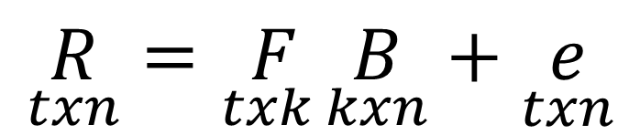
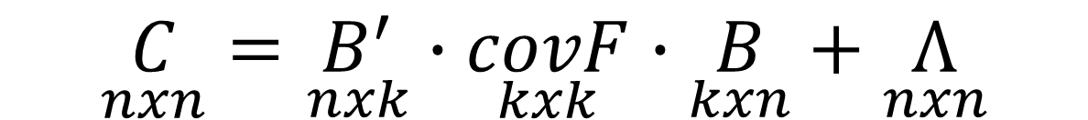
Factor Models – Always perform Dimension Analysis
$$\underset{txn}{R}=\underset{txk }{F}\underset{kxn}{B}+\underset{txn}{e}$$
$$\underset{nxn}{C}=\underset{nxk}{B^{′}}∙\underset{kxk}{covF}∙\underset{kxn}{B}+\underset{nxn}{Λ}$$

Slide 30
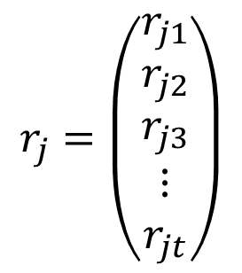

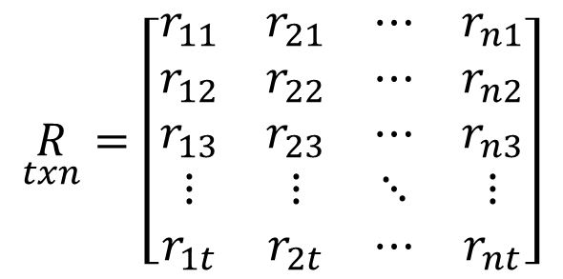
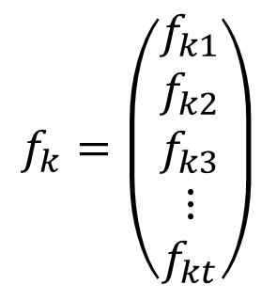
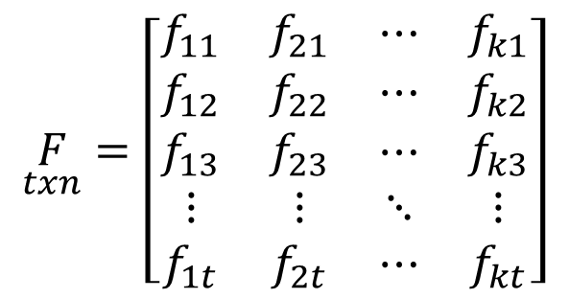

Matrix Notation
$$\underset{txn}{R}=\left[\begin{matrix}r_{11} & r_{21} & ⋯ & r_{n1} \\ r_{12} & r_{22} & ⋯ & r_{n2} \\ r_{13} & r_{23} & ⋯ & r_{n3} \\ ⋮ & ⋮ & ⋱ & ⋮ \\ r_{1t} & r_{2t} & ⋯ & r_{nt}\end{matrix}\right]$$
$$r_{j}=\left(\begin{matrix}r_{j1} \\ r_{j2} \\ r_{j3} \\ ⋮ \\ r_{jt}\end{matrix}\right)$$
$r_{jt}$= return for stock k at time t
$$\underset{txn}{F}=\left[\begin{matrix}f_{11} & f_{21} & ⋯ & f_{k1} \\ f_{12} & f_{22} & ⋯ & f_{k2} \\ f_{13} & f_{23} & ⋯ & f_{k3} \\ ⋮ & ⋮ & ⋱ & ⋮ \\ f_{1t} & f_{2t} & ⋯ & f_{kt}\end{matrix}\right]$$
$$f_{k}=\left(\begin{matrix}f_{k1} \\ f_{k2} \\ f_{k3} \\ ⋮ \\ f_{kt}\end{matrix}\right)$$
$f_{kt}$ = factor k value at time t

Slide 31

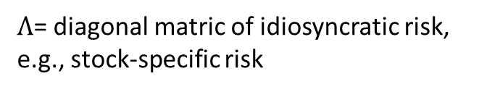
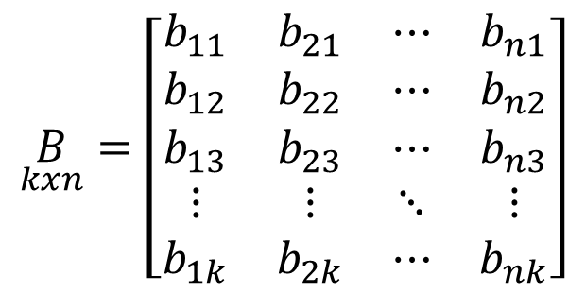


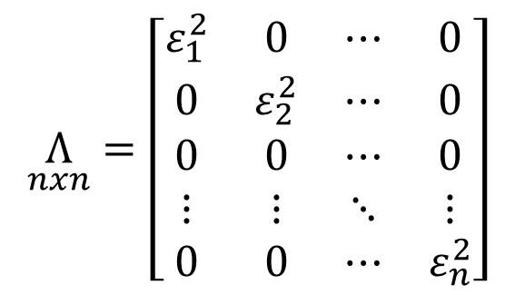
Matrix Notation
$$\underset{kxn}{B}=\left[\begin{matrix}b_{11} & b_{21} & ⋯ & b_{n1} \\ b_{12} & b_{22} & ⋯ & b_{n2} \\ b_{13} & b_{23} & ⋯ & b_{n3} \\ ⋮ & ⋮ & ⋱ & ⋮ \\ b_{1k} & b_{2k} & ⋯ & b_{nk}\end{matrix}\right]$$
$b_{jk}$= beta of stock j to factor k
$$\underset{nxn}{Λ}=\left[\begin{matrix}ε_{1}^{2} & 0 & ⋯ & 0 \\ 0 & ε_{2}^{2} & ⋯ & 0 \\ 0 & 0 & ⋯ & 0 \\ ⋮ & ⋮ & ⋱ & ⋮ \\ 0 & 0 & ⋯ & ε_{n}^{2}\end{matrix}\right]$$
$Λ$= diagonal matric of idiosyncratic risk, e.g., stock-specific risk
$ε_{j}^{2}$= stock specific variance for stock j
$ε_{j}^{2}$= “mse” from the regression or SeY^2

Slide 32
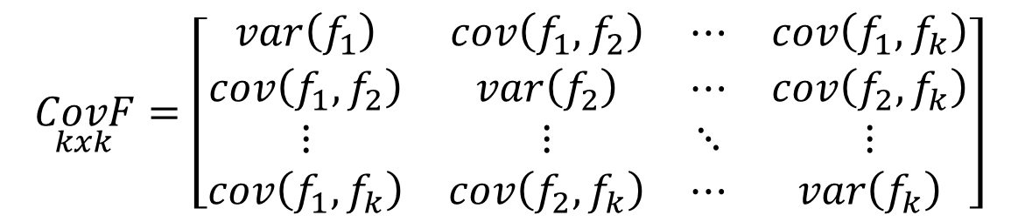
Matrix Notation
$$\underset{kxk}{CovF}=\left[\begin{matrix}var\left(f_{1}\right) & cov\left(f_{1},f_{2}\right) & ⋯ & cov\left(f_{1},f_{k}\right) \\ cov\left(f_{1},f_{2}\right) & var\left(f_{2}\right) & ⋯ & cov\left(f_{2},f_{k}\right) \\ ⋮ & ⋮ & ⋱ & ⋮ \\ cov\left(f_{1},f_{k}\right) & cov\left(f_{2},f_{k}\right) & ⋯ & var\left(f_{k}\right)\end{matrix}\right]$$
Factor Covariance Matrix = computed by definition

Slide 33
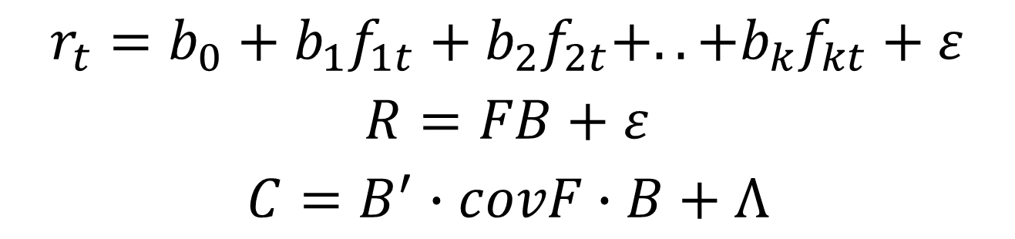
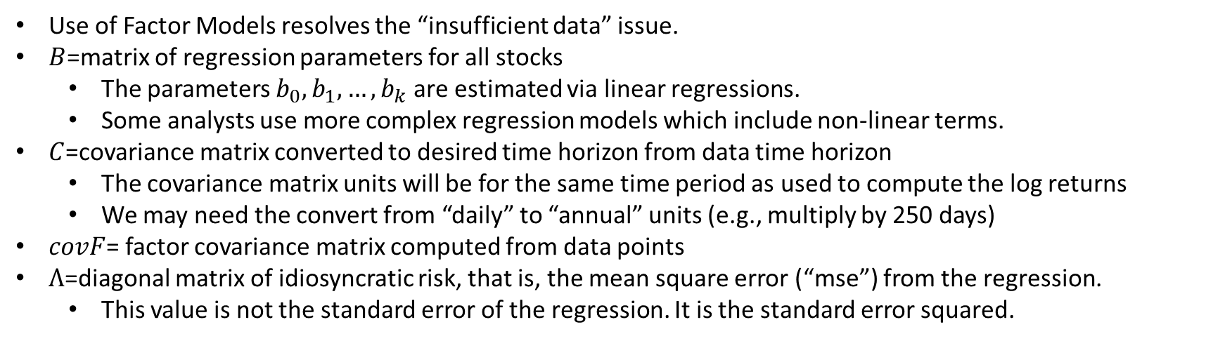
Factor Models
$$r_{t}=b_{0}+b_{1}f_{1t}+b_{2}f_{2t}+..+b_{k}f_{kt}+ε$$
$$R=FB+ε$$
$$C=B^{′}∙covF∙B+Λ$$
Use of Factor Models resolves the “insufficient data” issue.
$B$=matrix of regression parameters for all stocks
The parameters $b_{0}, b_{1}, …, b_{k}$ are estimated via linear regressions.
Some analysts use more complex regression models which include non-linear terms.
$C$=covariance matrix converted to desired time horizon from data time horizon
The covariance matrix units will be for the same time period as used to compute the log returns
We may need the convert from “daily” to “annual” units (e.g., multiply by 250 days)
$covF$= factor covariance matrix computed from data points
$Λ$=diagonal matrix of idiosyncratic risk, that is, the mean square error (“mse”) from the regression.
This value is not the standard error of the regression. It is the standard error squared.

Slide 34
Types of Factor Models
Times Series: regression uses time series data such as Index Returns (CAPM, Fama-French), or economic data such as GDP, Interest Rates, CPI, Balance of Payments, etc.
Fundamental Data: this is also referred to as cross-sectional models and uses stock specific data such as data from balance sheets, income statement, etc.
Statistical Factors: based on statistical analysis and often referred to as principal component analysis, eigenvalue decomposition, or singular value decomposition.

Slide 35
Types of Factor Models

Slide 36
Excel Example

